Slide 1
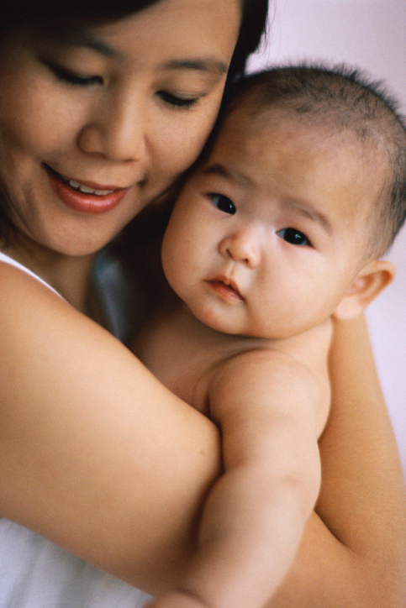
Hepatitis B and Your Healthy Baby
An Educational Slide Set for Women Who Have Hepatitis B
1
Centers For Disease Control and Prevention

Slide 2
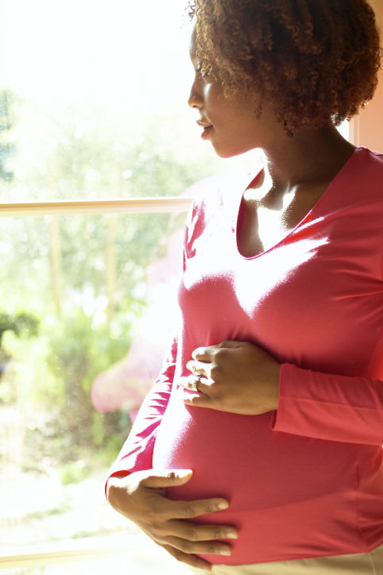
This is information for women who have Hepatitis B and are pregnant or have just had a baby. Hepatitis B can be very serious for new babies. This is about Hepatitis B and what you can do to help you and your baby be healthy.
2

Slide 3
What is Hepatitis B?
Hepatitis B is a serious illness that is very common in many different countries. About 350 million people in the world and over 1 million people in the U.S. have Hepatitis B. Unlike other serious illnesses, many people can have Hepatitis B and not feel sick .
3

Slide 4
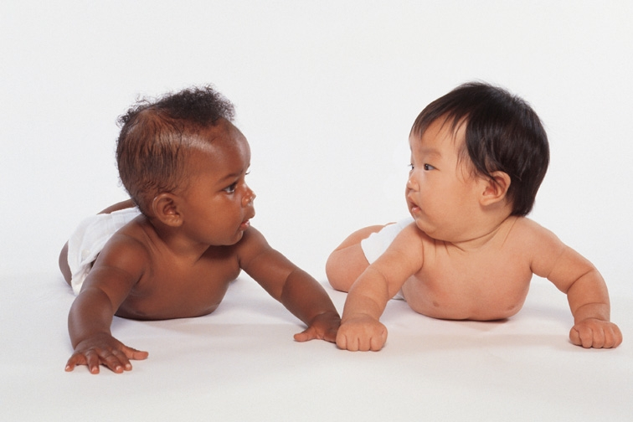
What causes Hepatitis B?
Hepatitis B is caused by a virus that infects a person’s liver. A virus is a germ that is too small to see, but can cause illness. There are many different kinds of viruses. The Hepatitis B virus is a virus that can stay in a person’s body for his or her life and cause serious liver problems.
4

Slide 5
The Liver and Health
The liver helps your body digest the food you eat and store energy. It also helps your body clean toxins out of your blood.
Over time, the Hepatitis B virus can cause damage to the liver. When the liver gets damaged, it does not do its job. This can cause serious health problems.
5

Slide 6
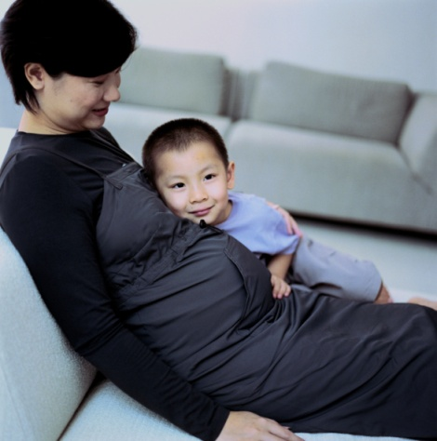
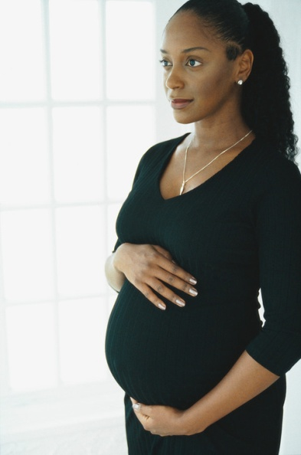
How does a woman know if she has Hepatitis B?
All pregnant women get a blood test to see if they have Hepatitis B.
If a woman has not seen a doctor before she delivers her baby, then she will be tested at the hospital.
6

Slide 7
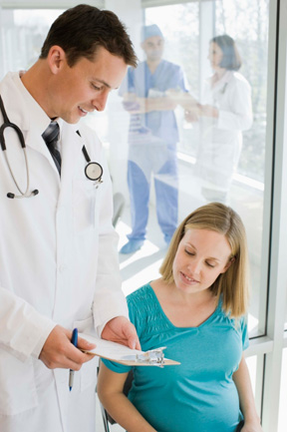
Why are women tested for Hepatitis B?
Women are tested for Hepatitis B because hepatitis is a serious disease that can harm both mother and baby.
A woman with Hepatitis B can give her baby the virus during childbirth.
This can happen if she has a vaginal birth or a c-section.
7

Slide 8
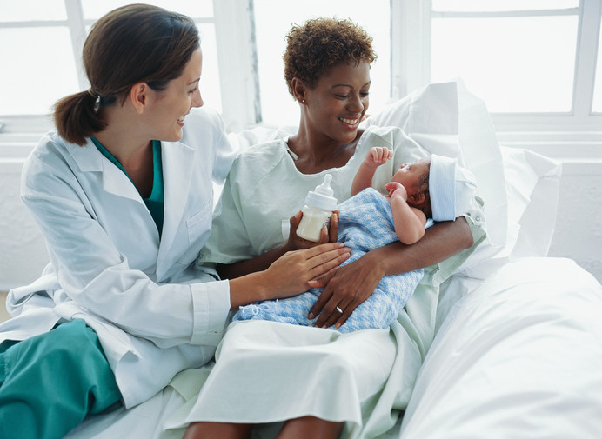
How can doctors stop babies from getting Hepatitis B?
All babies in the United States are given shots, or vaccine, to prevent Hepatitis B. When a woman has Hepatitis B, her baby gets two shots soon after birth. One is Hepatitis B vaccine and the other shot is called HBIG. These shots stop the virus from causing infection at the time of birth.
8

Slide 9
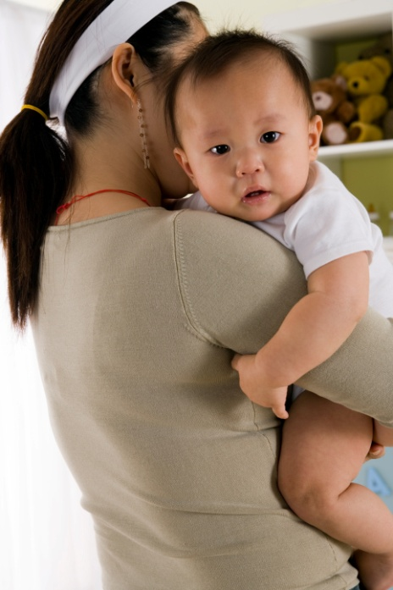
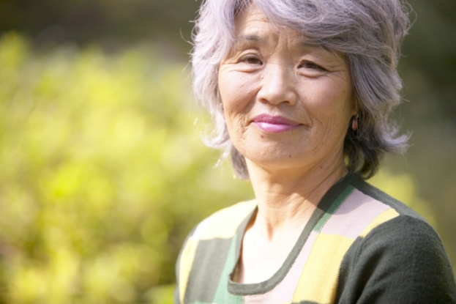
What is the Hepatitis B vaccine?
The Hepatitis B vaccine helps your baby fight Hepatitis B over his or her whole life.
9

Slide 10
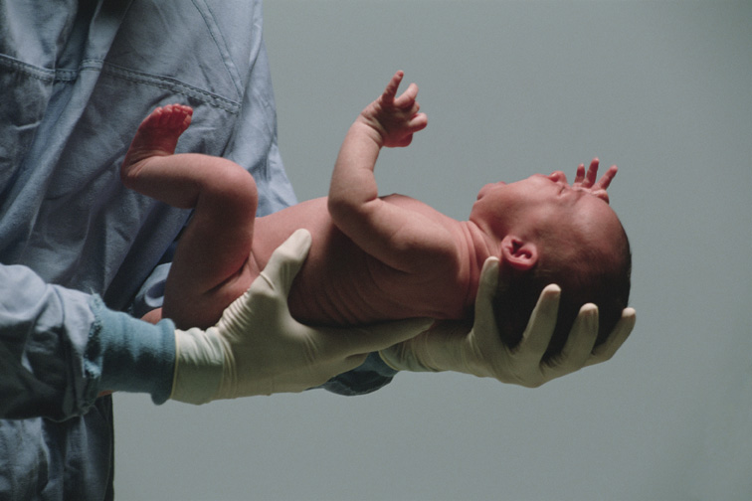
What is HBIG?
HBIG gives your baby a “boost” or extra help to fight the virus as soon as he or she is born.
10

Slide 11
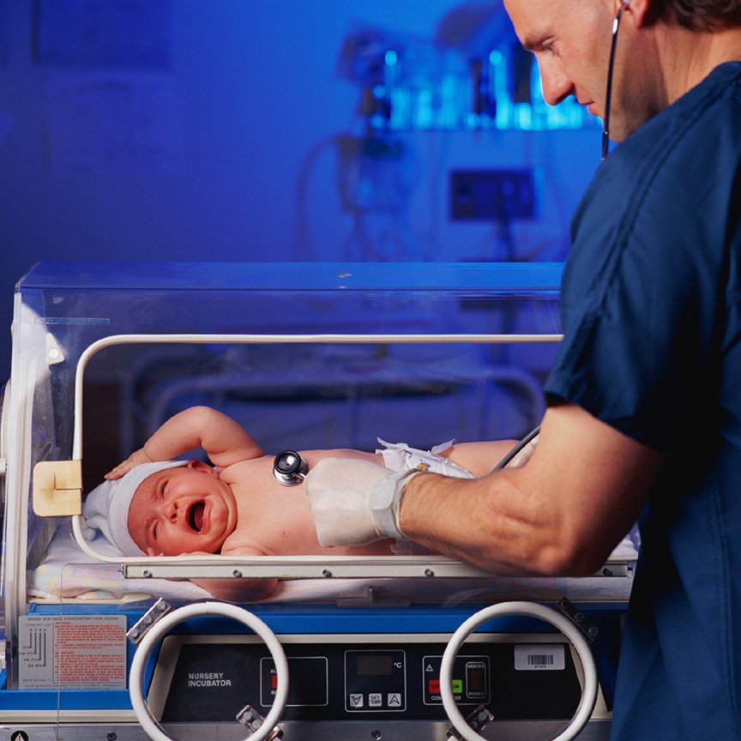
When does my baby get the shots?
The shots work best when your baby gets HBIG and the first dose of Hepatitis B vaccine within 12 hours of birth.
11

Slide 12
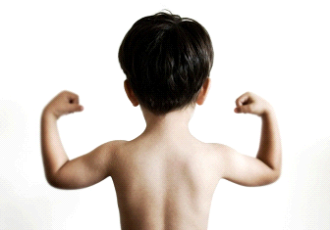
What do the shots do?
The vaccine helps the baby’s body to fight the Hepatitis B virus. It helps the baby keep from getting hepatitis from the mother or anyone else who might have Hepatitis B.
12

Slide 13
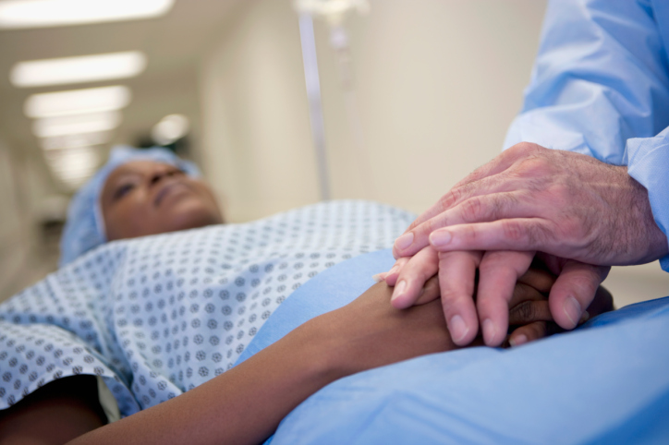
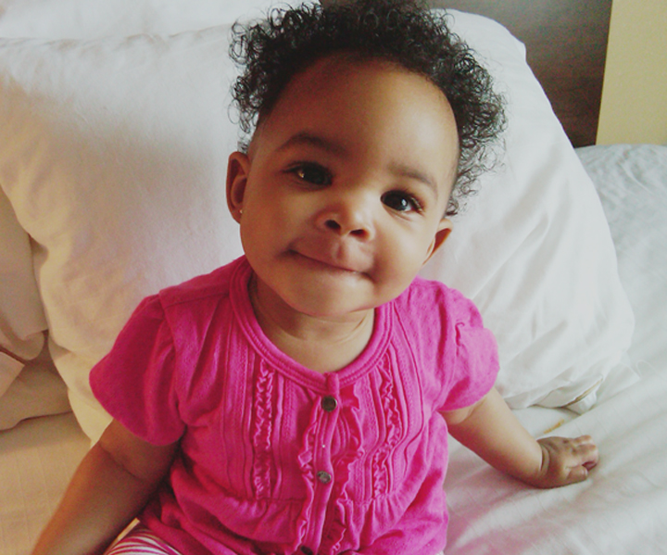
What happens if a baby does not get vaccinated?
Without the shots, babies born to mothers with Hepatitis B are much more likely to get Hepatitis B. The virus can cause serious health problems as the baby gets older.
13

Slide 14
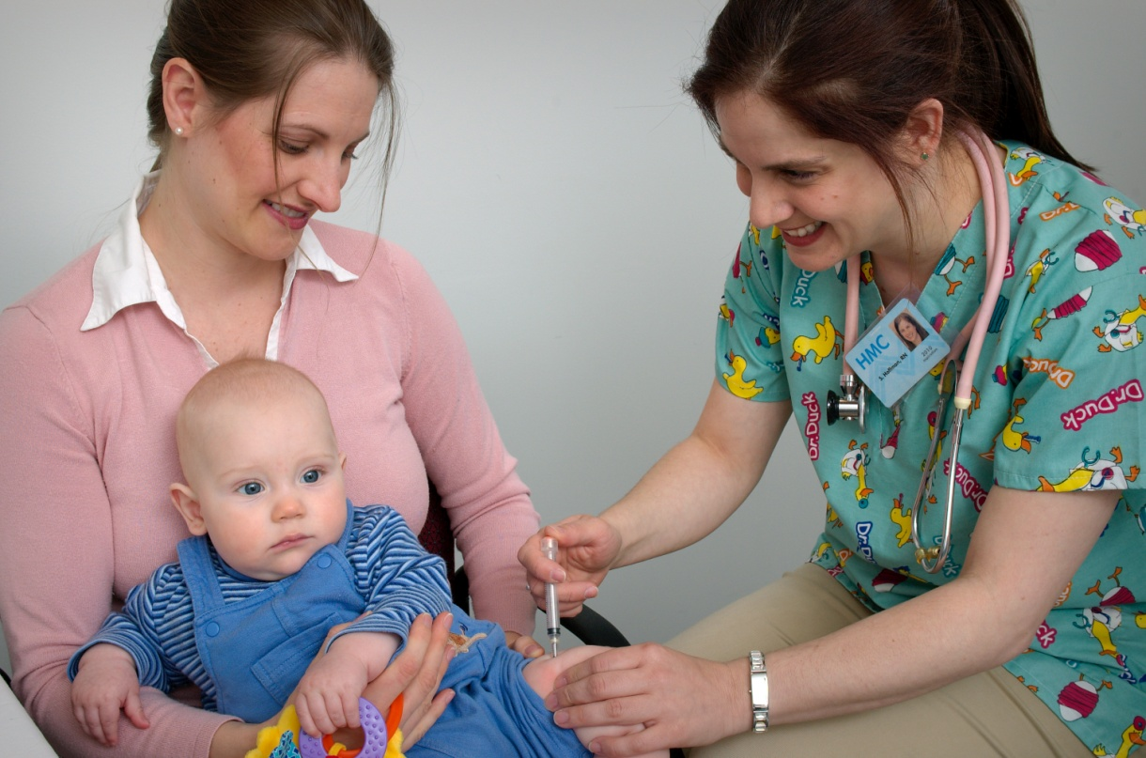
How many Hepatitis B vaccine shots do babies need?
Babies usually get 3 or 4 shots, depending on the brand of vaccine. Your baby’s doctor will tell you how many shots your baby needs.
14

Slide 15
When do I bring my baby to the doctor?
The second dose of Hepatitis B vaccine is usually given 1 or 2 months after the first dose.
Babies are usually given the last dose of Hepatitis B vaccine by the time they are one year old.
Ask your doctor or nurse to tell you when to come back.
15

Slide 16
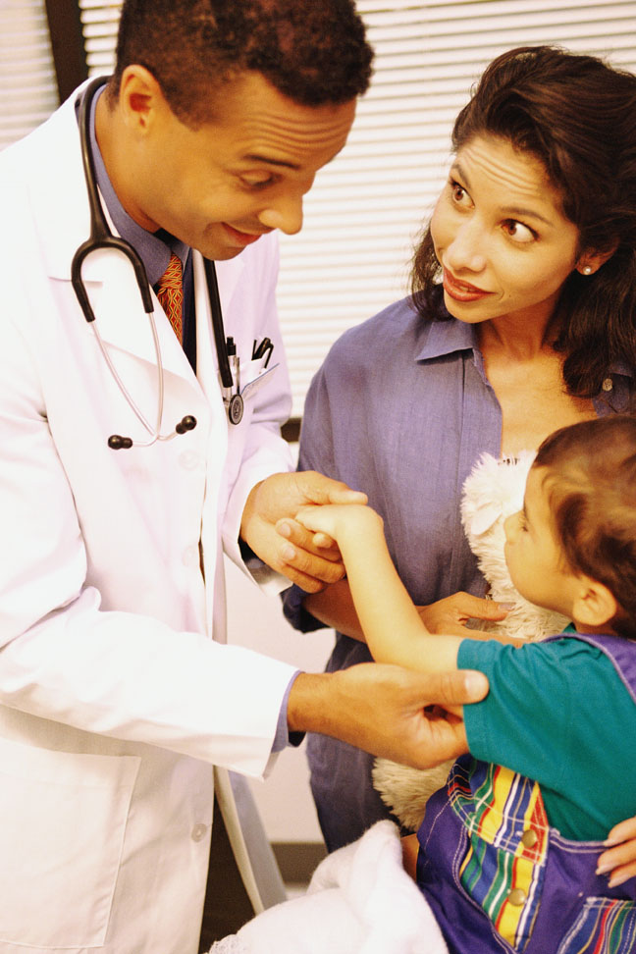
How do I know my baby is protected from Hepatitis B?
After getting all the shots, your doctor will do a blood test. The blood test is very important. It tells you and your doctor your baby did not get Hepatitis B and is protected. The blood test is usually done 1-2 months after the last shot.
16

Slide 17
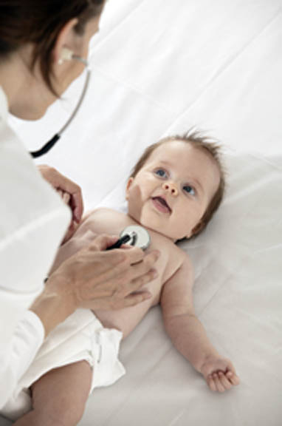
Your doctor will also ask you to bring your baby into the clinic for other shots and check-ups. This helps you have a healthy baby.
Hepatitis B shots are one of the important vaccines available to keep babies healthy.
Many women have questions about Hepatitis B and caring for their baby. Let’s go over a few of them…
17

Slide 18
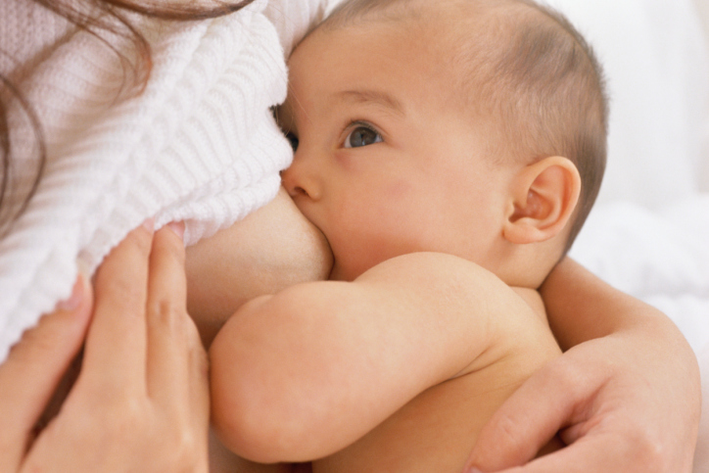
Can you breastfeed your baby?
Yes, you can breastfeed your baby. You cannot give your baby Hepatitis B from breast milk.
18

Slide 19
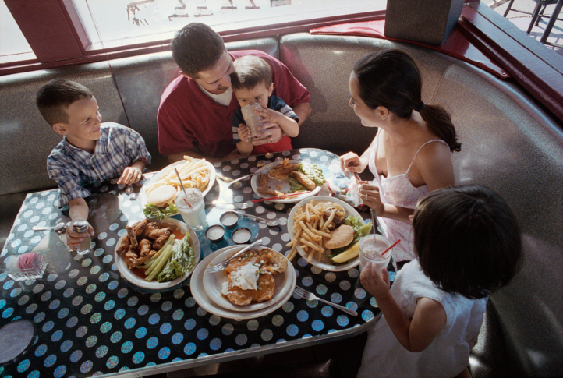
Can you eat with your family?
Yes, it is safe for you to prepare and eat meals with your family. Hepatitis B is not spread by sharing dishes, drinking glasses or utensils.
19

Slide 20
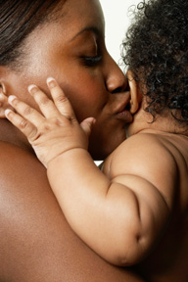
Can you hug and kiss your baby?
Yes, you can hug and kiss your baby and family members. You cannot give your family Hepatitis B from hugging and kissing them.
And Hepatitis B is not spread by coughing or sneezing.
20

Slide 21
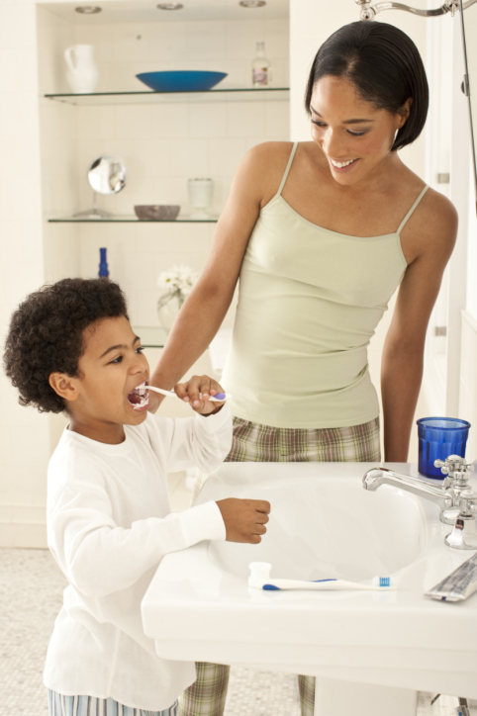
How do I protect my family every day?
It is important not to expose your baby and family members to any things that could have your blood on them.
Don’t share personal things like razors, nail clippers, toothbrushes, or glucose monitors. Cover cuts and sores while they are healing.
21

Slide 22
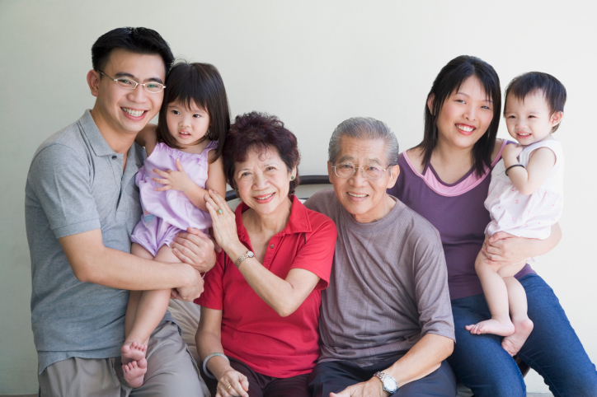
How can I make sure my family is protected?
Have everyone in your family go to the doctor or clinic to be tested.
This includes the baby’s father. Testing your family members helps to tell if they have Hepatitis B. If they do not, your doctor will talk to them about getting the Hepatitis B vaccine.
22

Slide 23
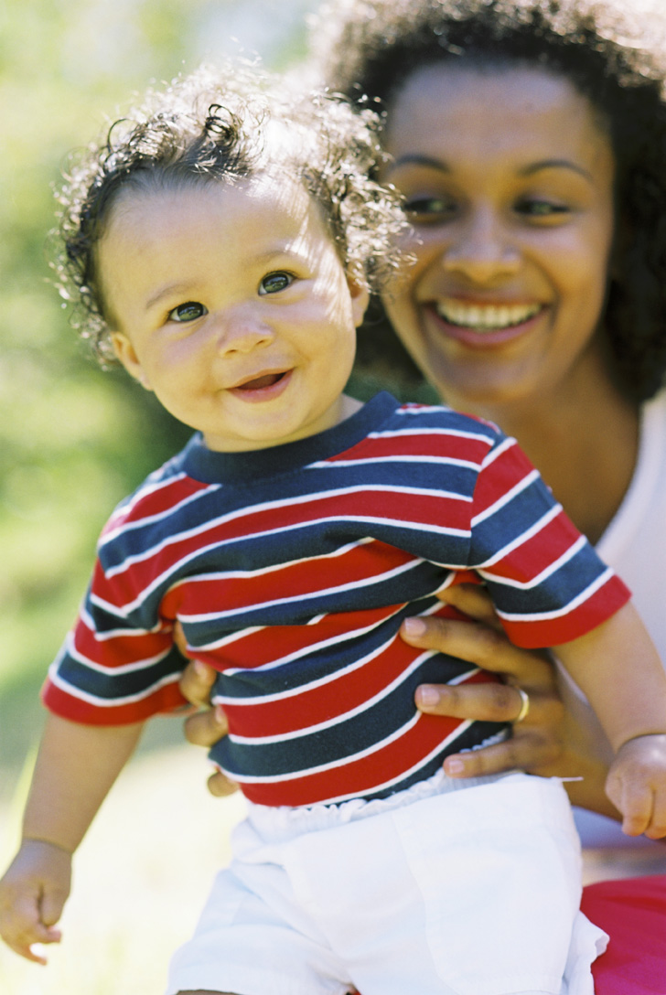
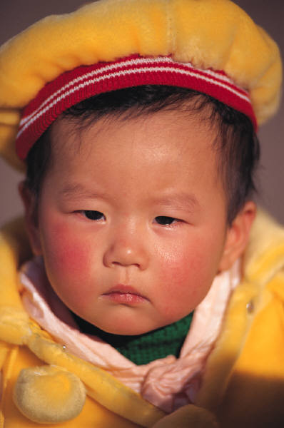
Your baby is counting on you!
Make sure to bring your baby back for the full set of Hepatitis B shots and the follow up blood test to make sure your baby is protected from Hepatitis B infection!
Do you have any other questions?
23

Slide 24
Centers For Disease Control and Prevention
s

