Slide 1


Community Information on the Hepatitis B Cure
October 1st, 2020

Slide 2

Participating in GoToWebinar
Join on computer via this link to view presentation:
Audio – choose computer audio” or “phone call”
  Phone Call: (415) 930-5229
  Access Code: 613-500-454
Attendees are in listen-only mode.
Questions - please type questions in chat box at anytime.
Questions? Submit questions in the chat box at anytime throughout the webinar.

Slide 3



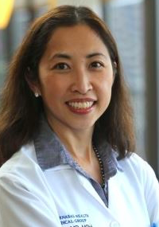
Speakers
John Tavis, PhD
Chari Cohen DrPH, MPH
Jake Liang, M.D.
Su Wang, M.D., MPH

Slide 4
HBV Cure Science 101
&
2019-2020 Research Progress
John Tavis, Ph.D.
Professor, Saint Louis University School of Medicine
Director, SLU Institute for Drug and Biotherapeutic Innovation

Slide 5
HBV Cure – Why do we need it?
Current drugs have big limitations
  Rarely cure patients and don’t stop disease in everyone
  Nucleos(t)ide analogs need to be taken for life
We really have only 2 flavors of drugs for HBV
  All nucleos(t)ide analogs work the same way on the same viral target
  All interferon α derivatives stimulate the same set of cellular immune responses

Slide 6
Biggest obstacle to curing HBV
HBV cellular replication cycle
cccDNA
The central molecule in HBV replication is the viral “cccDNA”
  The cccDNA is the template for all of the viral RNAs
  It is the master copy of the viral genome in cells
cccDNA appears to be long-lived in liver cells

Slide 7
So how do we get rid of the cccDNA?
Nobody knows!
But….
  Clearance of an acute infection gets rid of the vast majority of the cccDNA safely, so the immune system can do it!
  The cccDNA is not always completely eliminated during resolution of an acute infection
  The immune system can keep any residual cccDNA under control in almost all patients

Slide 8
So what is “HBV Cure”?
The goal is a Functional Cure
  A complete cure eliminates cccDNA, a functional cure does not
Functional cure is:
  No detectable cccDNA in cells or HBV DNA in the blood
  No disease progression
  Immune control of any residual cccDNA in the body
The clinical definition of a functional cure is undetectable HBV DNA and HBsAg in serum 6 months post-treatment

Slide 9
What will cure therapies look like?
Combination therapy will be needed because:
  HBV’s many genotypes and variable disease course mean no one drug will cure everyone
  cccDNA’s durability means we will have to hit it from multiple angles at the same time
Cure therapy is likely to be long (a year?) and need exceptionally safe drugs

Slide 10
What types of HBV drug discovery are ongoing?
Cure discovery research falls into 3 categories
  Direct-acting drugs that target HBV itself
  Host-targeted drugs that cause a patient’s cells to block HBV replication
  Immune-stimulating drugs that train the patient’s immune system to attack HBV
The work is being done in universities, biotech companies, and big pharma
Reference site: www.hepb.org/treatment-and-management/drug-watch/

Slide 11
HBV cure research targets
Reference site: www.hepb.org/treatment-and-management/drug-watch/

Slide 12
HBV cure research update 2020

Slide 13
Half-life of the cccDNA
“Half-life” describes how fast the cccDNA breaks down
The cccDNA has a very long apparent half-life
  But these data assumed therapy completely stops HBV replication
Looking at evolution and resolution of drug resistance in cccDNA implies a short half-life
  <11-22 weeks among 10 patients
VERY important because a short half-life indicates shorter treatment duration may be possible
Reference: Huang et al., 2020, Hepatology DOI: 10.1002/hep.31240

Slide 14
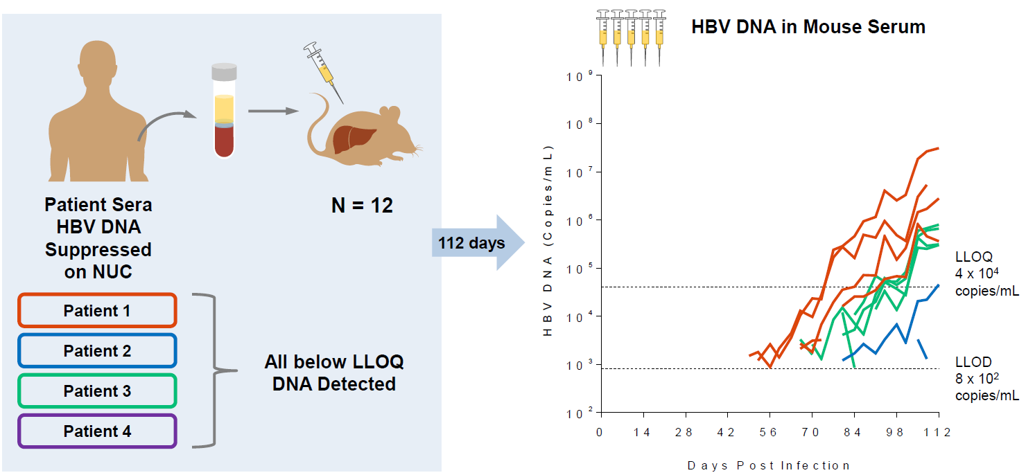
Infectious HBV in NA-treated patients
Nucleos(t)ide analogs (TDF, TAF, ETV) can reduce HBV replication below limit of detection or quantification
<LLD ≠ Not there!
Serum from patients with unquantifiable HBV levels caused infections in chimeric mice
Functional HBV is made during effective NA therapy
Reference: Burdette et al., 2020, EASL 2019

Slide 15
Capsid assembly modifiers
CpAM
Interfere with formation of
the viral capsid
Are in phase I (5x) or II (4x) clinical trials
Have very promising antiviral efficacy
  Example: 32%(13 of 41) patients treated with JNJ-56136379 had undetectable HBV DNA at day 29
Some drugs have failed due to toxicity, but the leading compounds are well tolerated
HBV develops resistance to some of them easily
Reference: Zoulim et al., 2020, Gastroenterology 159:521-533

Slide 16
Bulevirtide (Myrcludex B, Hepcludex)
HBV cellular replication cycle
Hepcludex
An injectable drug that stops HBV from entering cells
Conditionally approved in Europe vs. HDV
In phase II clinical studies vs. HBV
  Safe and effective so far

Slide 17
Durability of HBV suppression by siRNAs
siRNAs cause the HBV mRNAs to be broken down
Work by blocking production of the viral proteins
In phase I (1x), I/II (2x), and II (1x)
15 of 38 patients who responded well to JNJ-3989 had durable post-treatment HBsAg suppression (average 2.0 log₁₀ suppression at 1 year)
Durability could be due to partial reactivation of anti-HBV immune responses

Slide 18
Functional cure by NAPs (Rep 401 study)
Nucleic acid polymers block secretion of HBsAg from cells
Phase 2 study of 40 HBeAg-negative patients with NAPs+Viread+PegIFNα
39% (14 of 36) patients completing the 2-year trial achieved functional cure
Flares occurred in all patient with good responses
Requires weekly injection of IFN and NAPs
Reference: Bazinet et al., 2020, Gastroenterology 158:2180

Slide 19
Take-home messages
The goal is a Functional Cure
Combinations of drugs that work different ways are needed
Understanding of how HBV persists has been improved
Many promising drug candidates are being developed
Functional cure rates up to ~40% have been seen in a Phase 2 study
There is HOPE!

Slide 20

HBV Cure Community Perspective & Hepatitis B Foundation Initiatives
Chari Cohen, DrPH, MPH
Senior Vice President, Hepatitis B Foundation
Associate Professor, Baruch S. Blumberg Institute

Slide 21

What does the community want and need?
What is the impact of living with hepatitis B on the lives of those chronically infected?
  Physical, emotional, professional and social impact
  Experiences with stigma and discrimination
What do patients prioritize in terms of treatment?
  Treatment experiences and thoughts on future/ideal treatment
How can we improve clinical trial participation, and ensure diversity and inclusion?
How can we include patient reported outcomes into future hepatitis B treatment regimens and clinical trials?
Notes:
Beliefs on clinical trial participation and thoughts on how to improve participation

Slide 22
Documenting the lived experience
Methodology
Hosted Externally-Led Patient Focused Drug Development Meeting June 2020
Conducted 25 in-depth interviews with people who have chronic hepatitis B
Completed data mining and qualitative analysis of 10,000 patient email consults
Conducted online survey (U.S. and international)
Hosting focus groups (2021)
Notes:
Clarify and document the physical, emotional, professional and social impact
Experiences with stigma and discrimination – and impact on care and treatment
Treatment experiences and thoughts on future/ideal treatment – including current treatment challenges
Focus on treatment-related wants, needs and challenges – and thoughts/PROs for future treatments and clinical trials
Beliefs on clinical trial participation and thoughts on how to improve participation

Slide 23
Interview and PFDD findings: Impacts of chronic hepatitis B
There is significant physical and emotional impact for people living with hepatitis B that appears to reduce quality of life and enjoyment of daily life
  fatigue, shame, stigma, isolation and fear of liver cancer/dying prematurely
Living with chronic hepatitis B impacts familial and social relationships, as well as education and jobs/careers
Current treatment challenges include cost/access, and taking a daily pill for many years
There is a strong desire for loss of HBsAg and reduction of risk for liver cancer, with a finite treatment

Slide 24
Interview and PFDD findings: Future treatments and clinical trials
The preference was for oral treatment, but injectables were also acceptable by many
Mild, limited symptoms were considered acceptable by most
Participants were interested in clinical trials, with caveats:
  Clear safety information – assurance of non-lasting damage
  Less disruption on daily life (travel to site, side effects, timing)
Those with young children, or who were older, were more hesitant about clinical trials
A success rate of 50-70% would be needed for most to choose participate in a clinical trial

Slide 25
Survey responses
1,707 respondents
Average age was 37 years old (range 19-75)
67% identified as male and 26% identified as female (7% preferred not to answer)
83% lived outside the United States, representing 99 countries
Top 5 countries represented were: Nigeria (29%), U.S. (17%), Ghana (10%), India (9%) and Philippines (7%)
Notes:
National = 320
International = 1,610
Currently conducting descriptive and inferential analysis

Slide 26
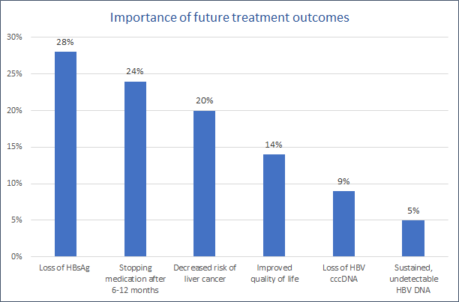

Slide 27
Most important outcomes of ideal treatment
U.S.
Decreased risk of HCC
Loss of HBsAg
Being able to stop meds after 6-12 months
Improving quality of life
Loss of cccDNA
Long-term DNA suppression
International
Loss of HBsAg
Being able to stop meds after 6-12 months
Decreased risk of HCC
Improving quality of life
Loss of cccDNA
Long-term DNA suppression

Slide 28
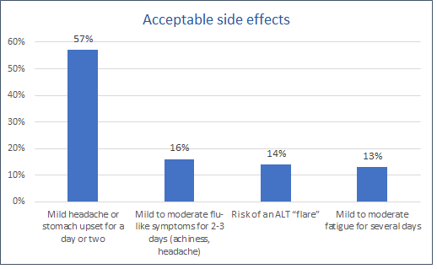

Slide 29
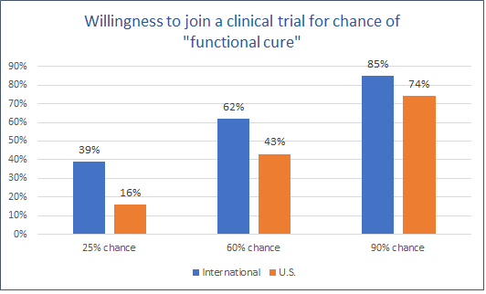
Notes:
About half (53%) of international respondents said they are not under the care of a medical provider.
(41%) stated that they could not find a medical provider to manage their hepatitis B
51% stated that they could not afford to see a medical provider.
Fewer international respondents were treated for hepatitis B compared to U.S. residents (32% international vs. 54% U.S.).
The most stated reason for non-treatment was cost: 67% of international respondents said cost was a challenge vs. 52% of U.S. respondents.
Additionally, international respondents described missing medication doses more often than U.S. respondents: 9% missed a dose every other day compared to less than 3% of U.S. respondents.
International respondents more often stated that life was less enjoyable (60% international vs. 46% U.S.), and more often stated that they avoided others (42% international vs. 34% U.S.) because of their hepatitis B.
International respondents were also more worried about: transmitting hepatitis B to others (67% international vs. 51% U.S.), facing discrimination (66% international vs. 51% U.S.), that their relationships were negatively impacted (47% international vs. 41% U.S.), and that their ability to do their job was negatively impacted by hepatitis B (45% international vs 40% U.S.).

Slide 30
What Happened to the Cure?
We need to better communicate with those impacted around the world regarding drug development and progress towards a functional cure.
Call to action – we need to prioritize hepatitis B!
  There is still not enough prioritization or funding to eliminate hepatitis B;
  A functional cure would be the trigger for a paradigm shift;
  Individuals around the world need a stronger voice advocating for hepatitis B & inclusion in country-level elimination planning;
  We need to improve screening and linkage to care, and eliminate stigma and discrimination NOW, to get the world ready for a functional cure.
  https://www.hepb.org/news-and-events/commentary-on-the-cure/

Slide 31
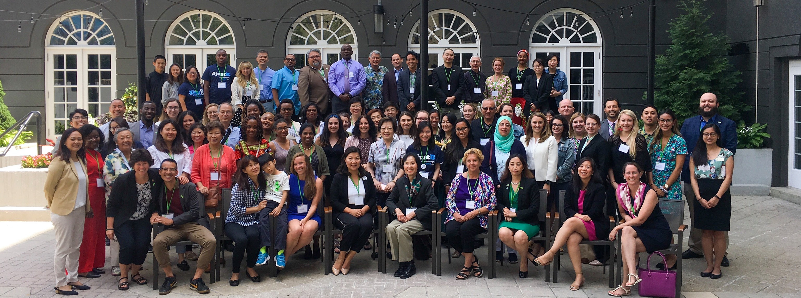
Thank You
Questions?
Chari.Cohen@hepb.org
www.hepb.org

Slide 32
ICE-HBV and NIH initiatives on
HBV Cure
2020 Update
T. Jake Liang, M.D.
NIDDK, NIH
ICE-HBV Governing Board Member

Slide 33
ICE-HBV was formed in 2016 and aims to establish an international collaboration to facilitate the discovery of a safe, effective, affordable and scalable cure to benefit all people living with CHB, including children and people living with HCV, HDV and HIV co-infection.

Slide 34
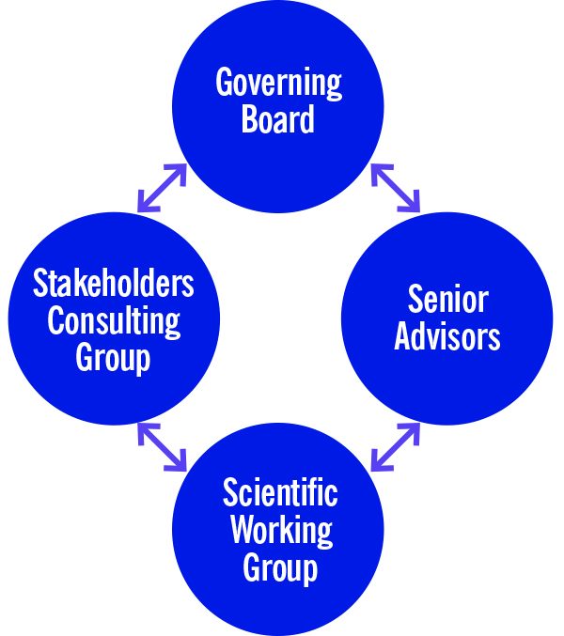
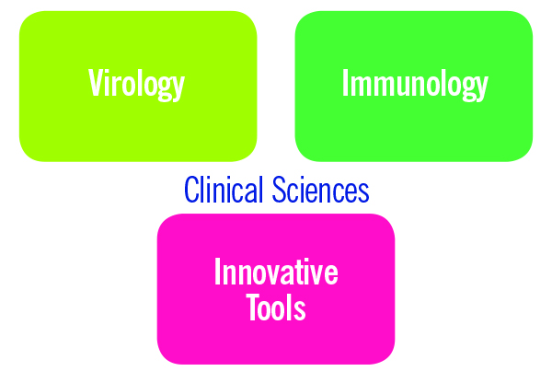
A Global Scientific Strategy towards Cure of Chronic Hepatitis B Virus Infection
Revill et al. The Lancet Gastro. Hep. April 2019

Slide 35
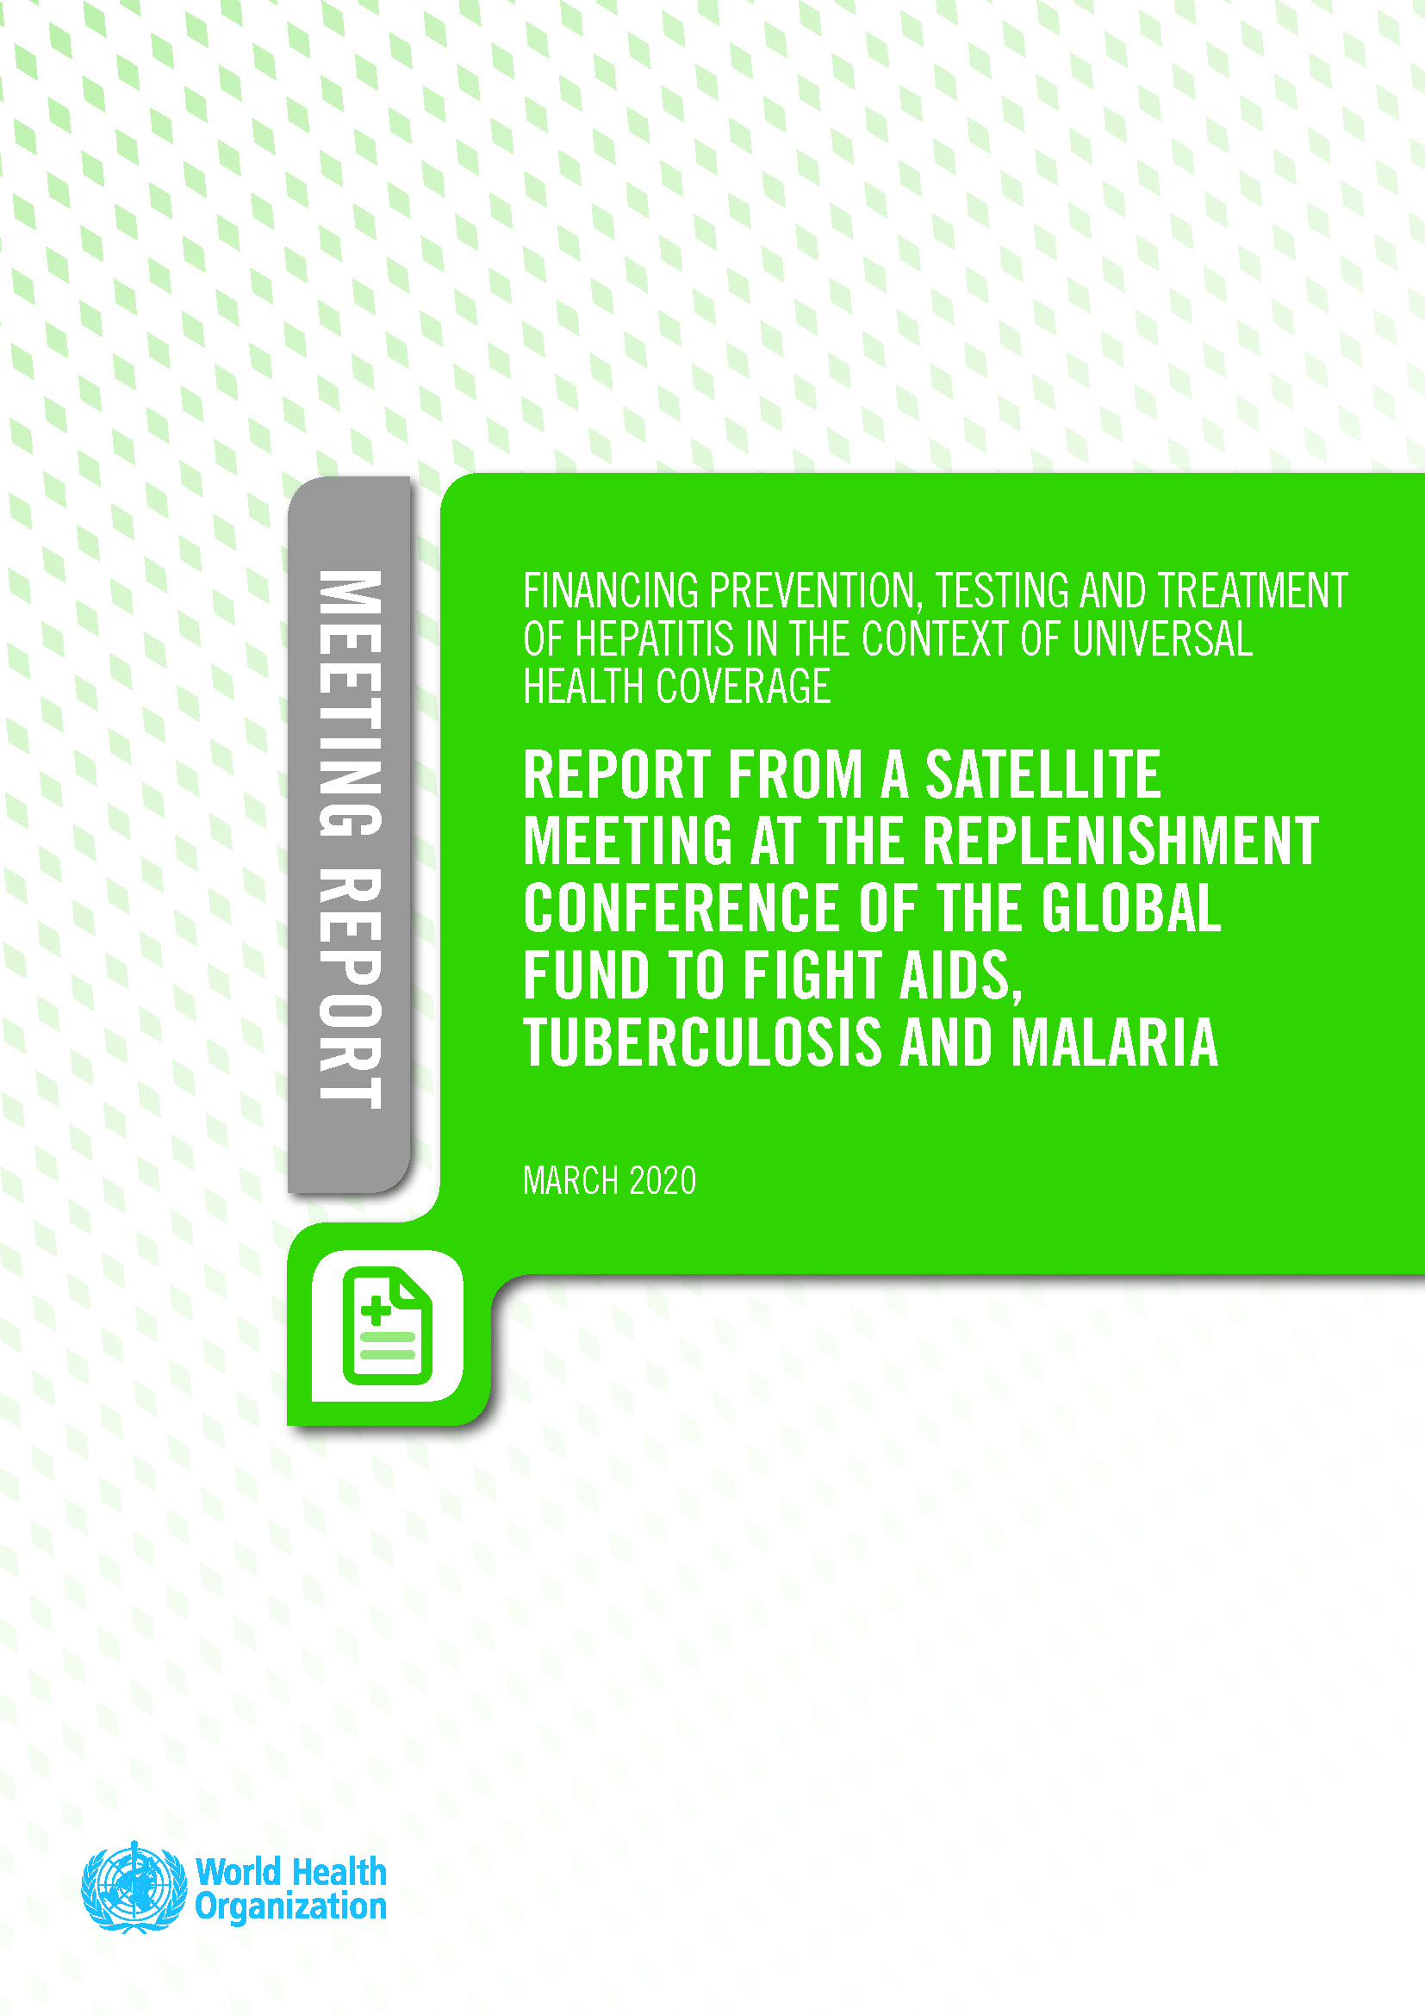
Actions Required to Achieve HBV Cure
ICE-HBV Strategy
INCREASE funding for individual and collaborative cure-related research projects by governmental and private funding agencies and philanthropic organizations.
HBV cure research investment strategies should be prioritized in national plans globally => ICE-HBV contributed to inclusion of HBV in G-Finder Report.
Hepatitis elimination should be included in global health programs:
  Side-Event at the Global Fund replenishment meeting in Lyon, October 2019
  WHO Report on Synergies Between Viral Hepatitis Elimination and Universal Health Coverage, March 2020.

Slide 36
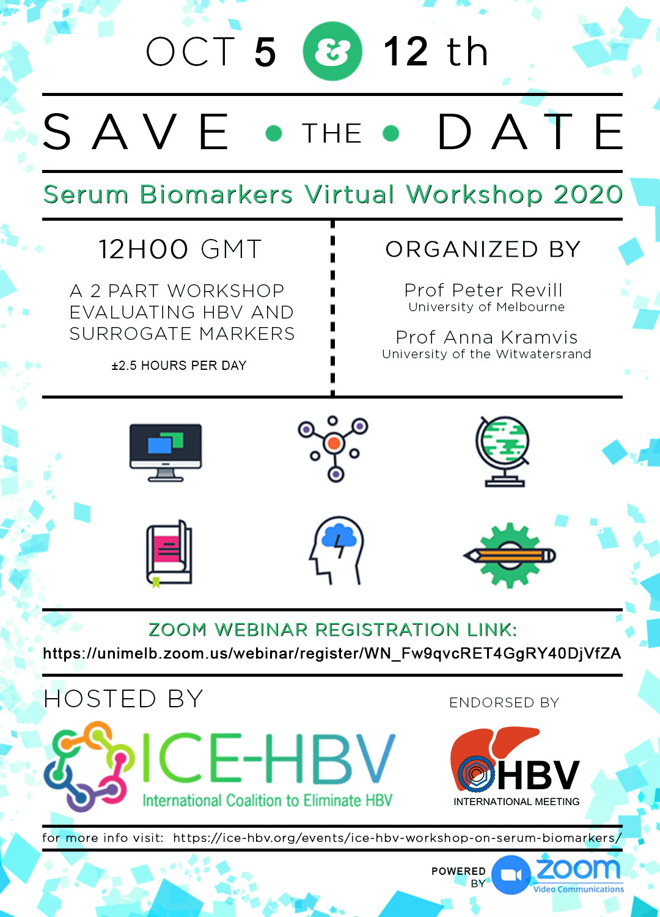
Actions Required to Achieve HBV Cure
ICE-HBV Strategy
CONCENTRATE on the discovery of therapeutic strategies that will permanently reduce the number of productively infected cells and/or permanently silence the cccDNA in those cells AND that will stimulate HBV-specific T cells and the production of antibodies that will prevent viral spread to uninfected cells, mimicking spontaneous resolution of HBV infection
HBV Cure Serum Biomarkers Workshop in 2020
Ongoing cccDNA working group
HBV Cure 101 Webinar at COLDA 2020

Slide 37
Actions Required to Achieve HBV Cure
ICE-HBV Strategy
ESTABLISH repositories of standardized HBV reagents and protocols and facilitate access to all researchers across the world and support the development of a new animal model.
ICE-HBV Open Access Protocols Database (Haitao Guo & group):
  Virology in 2019
  Immunology in 2020
In-vivo Models Workshops 2020
NIAID Reagents Repository

Slide 38
Repository for Advancing HBV Cure Research is underway (NIAID-NIH)
Peptide libraries for clinical immunology studies
Monoclonal antibodies against HBV proteins
Viral DNA, RNA and protein standards
Replication competent HBV clones of various genotypes
Compound libraries for studies in experimental models
Cell lines susceptible to HBV replication and cell to cell spread
Mouse and primate models susceptible to HBV infection
Collection of serum and liver biopsy samples from cohort study for research purposes

Slide 39
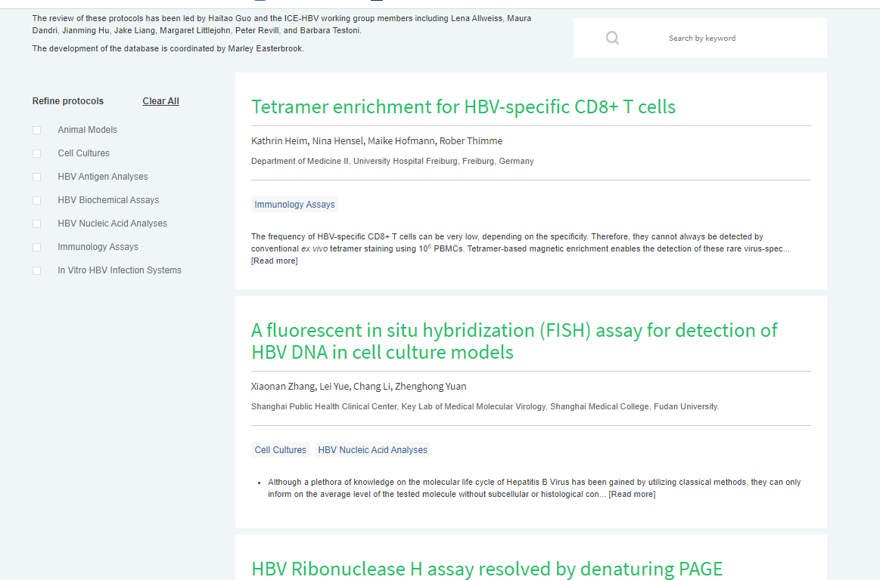
HBV Research Protocols
Complement the upcoming NIAID reagents repository by making corresponding quality-controlled research protocols available freely for all researchers around the world.
Current Categories:
  In vivo Models
  Cell Cultures
  HBV Antigen Analyses
  HBV Biochemical Assays
  HBV Nucleic Acid Analyses
  Immunology Assays
  In Vitro HBV Infection Systems
Submit protocol ideas to info@ice-hbv.org

Slide 40
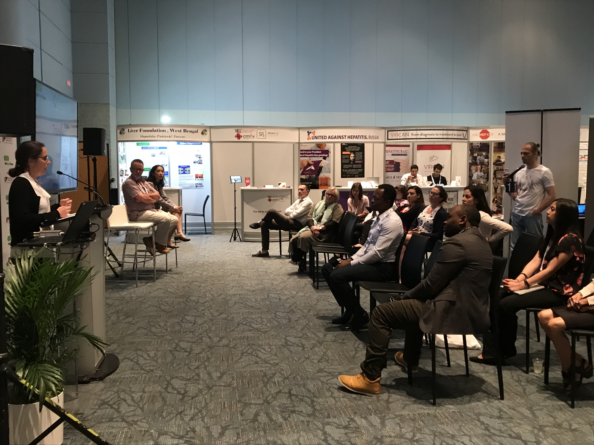
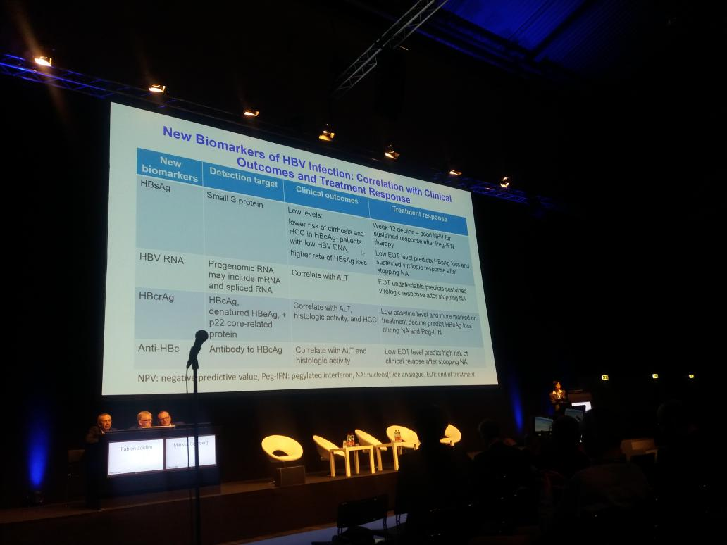
Next Steps
EASL / ICE-HBV Think Tank on HBV cure. Amsterdam, April 2021
Public Forum: International HBV Meeting, Toronto, September 2021
HBV Management in Resources-Limited Setting Project
  Led by Daryl Lau
  Researchers and clinicians from all WHO regions
Public forum at Global Hepatitis Summit
in Toronto June 2018
EASL & ICE-HBV Think Tank in Vienna
April 2019

Slide 41



2019-2020 Financial Supporters
Donors
ANRS
Australian Academy of Sciences
The Doherty Institute
The International HBV Meeting
The Hepatitis B Foundation
The Ray Schinazi Family Foundation
Major Industry Sponsors
Key Industry Sponsors

Slide 42
NIH-DHHS Efforts in “HBV Cure”
U.S. National Viral Hepatitis Action Plan (2011)
  HBV cure and prevention a major focus
  2017-2020; 2021-2025
Strategic Plan for Trans-NIH Research to Cure Hepatitis B (Nov 2019)
Increased NIH funding: $15 mil in 2010 to $70 mil in 2020: mostly research grants, some small business contracts, antiviral testing service, clinical trials
NIAID Repository of HBV reagents

Slide 43


Slide 44



The Road to HBV Cure
Patients, Stigma & how
Lived Experience can Drive Change
Su Wang, MD MPH FACP
President, World Hepatitis Alliance
Medical Director, Center for Asian Health
Saint Barnabas Medical Center
su.wang@rwjbh.org @swang8
October 1, 2020
Notes:
I want to thank the organizers for inviting me to be here today. It is a real pleasure to finally be here in Australia and at this amazing meeting.
I am so impressed with what you have done here- convening physicians, nurses, researchers, pharmacists, researchers and patients. This is a real example of what elimination is all about.
So a little about myself. My parents immigrated from Taiwan to the US where I was born. I am a internal medicine physician with a public health background. I used to live/work in NYC where I first started caring for hepatitis patients in Chinatown Manhattan. Our program became known for it’s primary care based care of Hep B patients and I was really proud of our Hep B mom’s care program which followed pregnant women through their pregnancy and then their infant post vaccination etc.
If you had asked me to give a talk with this kind of title 5 years ago, I would have brushed it aside thinking that it wasn’t a very important topic. And the really important matters were the research studies being presented at specialty conferences about the latest studies. In fact, when I first joined the board at the World Hepatitis Alliance and we were talking about physicians starting patient groups, in the back of my mind, I felt those were the soft things of medicine, the froofroo aspects.
I realize now I had pushed my identity as someone living with hepatitis B to the back of my mind (and like many others who self stigmatize, didn’t really want to deal with the fact that I myself was living with the disease and what the ramifications might be). But I was in meetings always lamenting about how we culdn’t find patients to tell their stories and I started feeling a bit hypocritical for not talking about my own story. And it was actually hearing the stories of my peers, fellow board members of WHA- Dee Lee, Michael Ninburg, Charles Gore– that made me finally pause and think through my own experience and how I had wrestled with the diagnosis and experience the same fears, guilt and even shame that I told my patients not to worry about. And it’s actualy when I hear the stories of patients who are hopeless, afraid, despondent, that I realize how important it is for us who can, to speak out.
So I would say I’ve realized now that this whole patient voice bit, which I had thought was froofroo is actually thus far the most important role of my career.

Slide 45
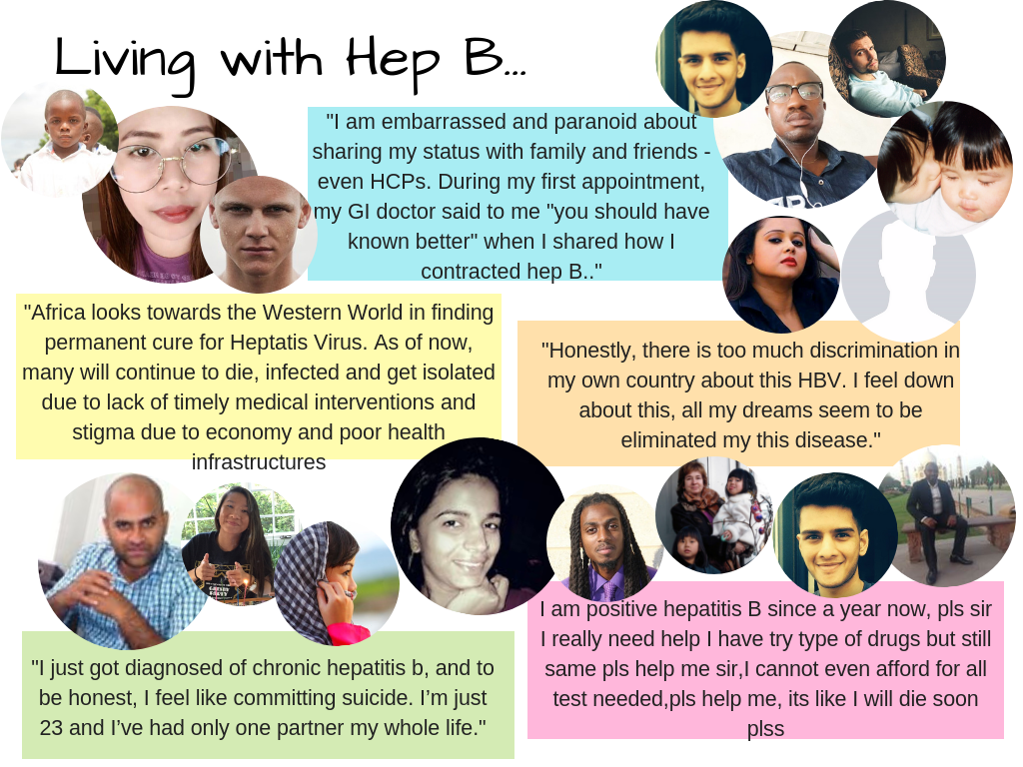
Slide courtesy of Maureen Kamischke, Hepatitis B Foundation

Slide 46




‘
325M AFFECTED 290M UNDIAGNOSED
Demand access
Drive prevention
Diagnosis and awareness
Save lives
Create support
Encourage innovation
Notes:
-With 325m affected but upwards of 290m not diagnosed, we need to FIND THE MISSING MILLIONS.
-Diagnosis will drive prevention, awareness, access to treatment. It will save lives and as a global organization representing the voices of the affected community, we have a massive role to play in this.

Slide 47
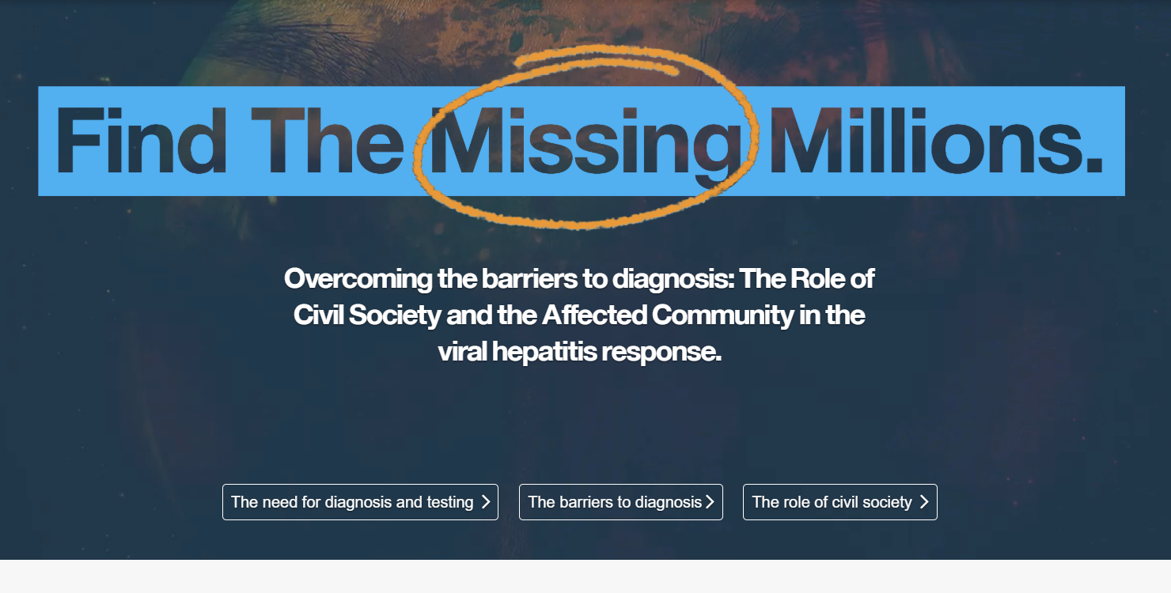
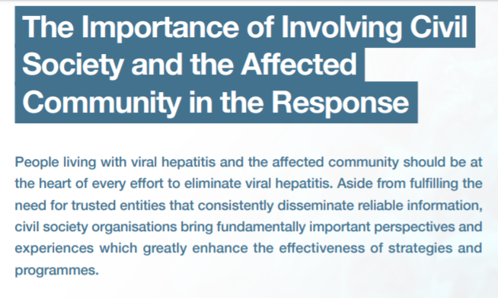

Slide 48


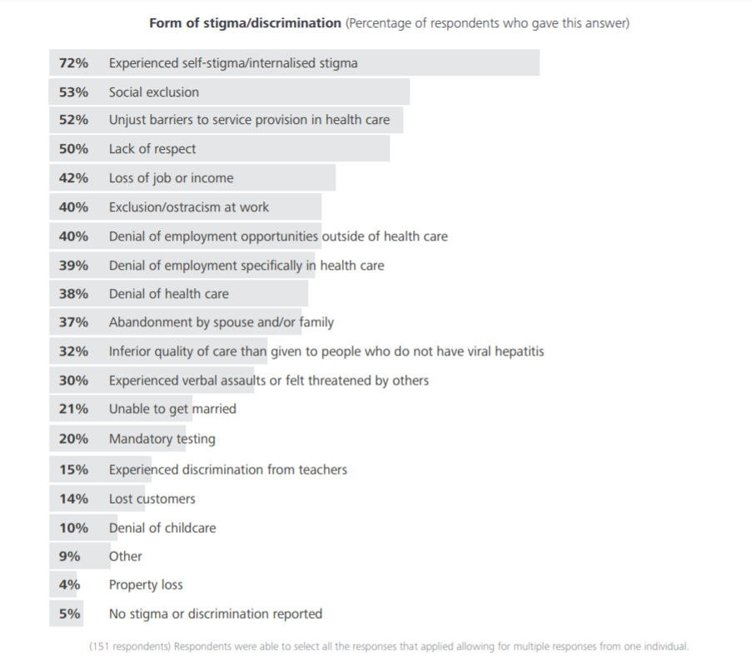
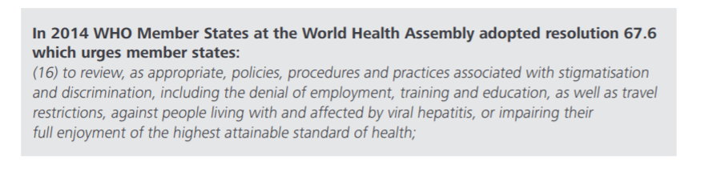
Holding governments accountable: World Hepatitis Alliance civil society survey global findings report.
World Hepatitis Alliance, London; 2017 http://www.worldhepatitisalliance.org/sites/default/files/resources/documents/holding_governments_accountable_-_civil_society_survey_report.pdf

Slide 49

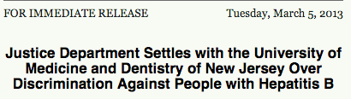
Student & Healthcare worker discrimination in the US
2011 Two medical students lose acceptances over HBV diagnosis, DOJ brought in
2012 CDC updates guidelines for health care students & professionals with hepatitis B
2013- People w hepatitis B officially protected under the American Disabilities Act
2013- Letter sent from DOJ, Dept of Education, Heath & Human Services to healthcare schools
Yet, the Hepatitis B Foundation continues to receive 20-30 cases/year of students or professionals facing discrimination
Nurses, physicians, x-ray technicians, physical therapists, dentists, ulrasonographers
Notes:
What are some of the barriers out there to diagnosis?
Lack of overall awareness.
These are some of the many components that can come in to play
Here you see how stigma effects so much of ones life
When they look at QOL scores of people with HBV, it’s not the physical symptoms that impact them the most, it’s the stigma that impacts their life
In many parts of the world, people with HBV cannot study, work certain jobs, must eat at separete tables from family members and coworkers, they are left at the alter or divorced- it completely destroys their lives. This is often what keeps people from getting tested or in care- they would rather not know and have to deal with consequences. Body double. We don’t hear much about it in the US but in other countriespeople w HBV commit suicide because of the hopelessness they feel

Slide 50
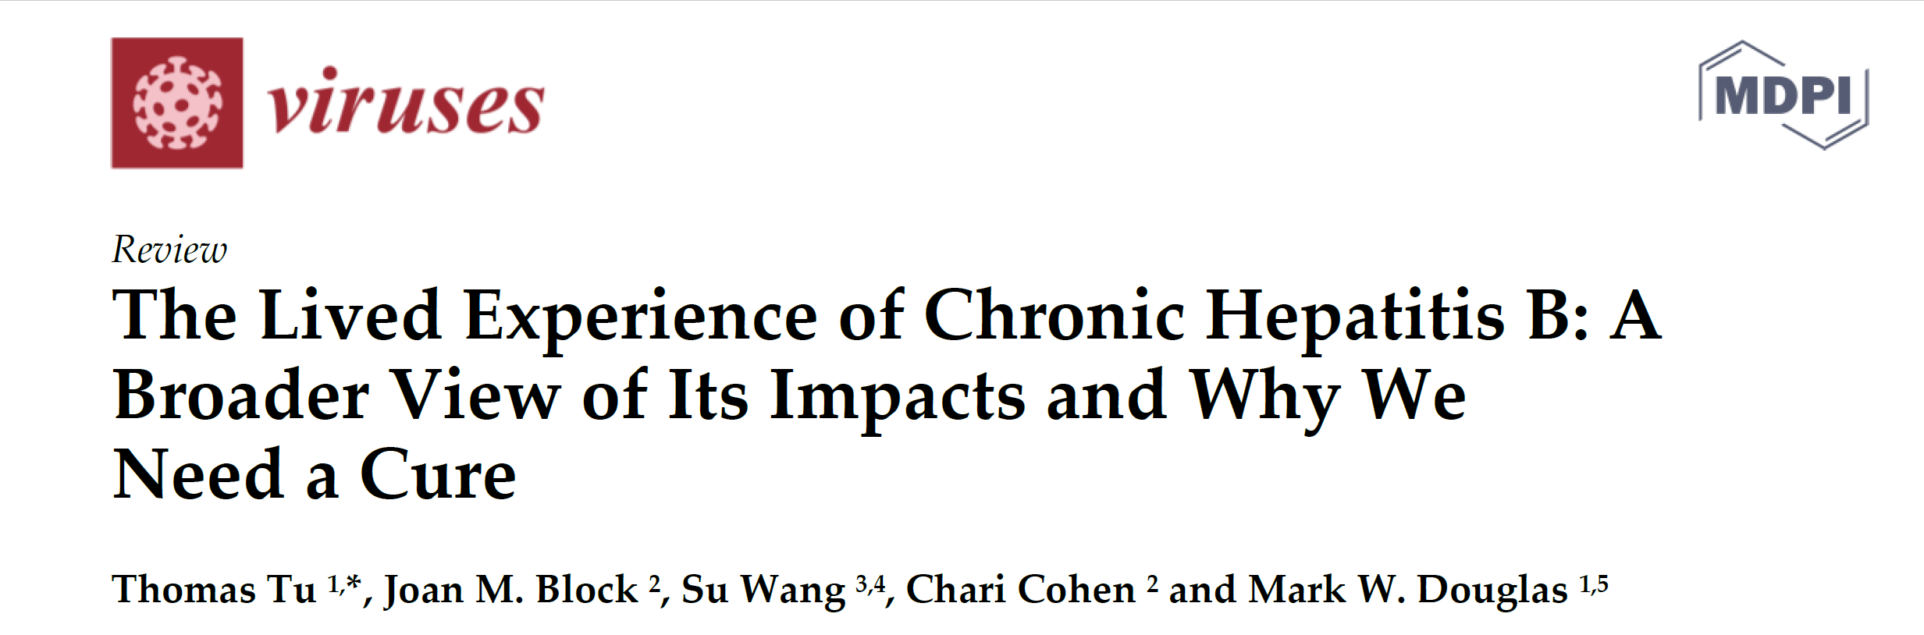
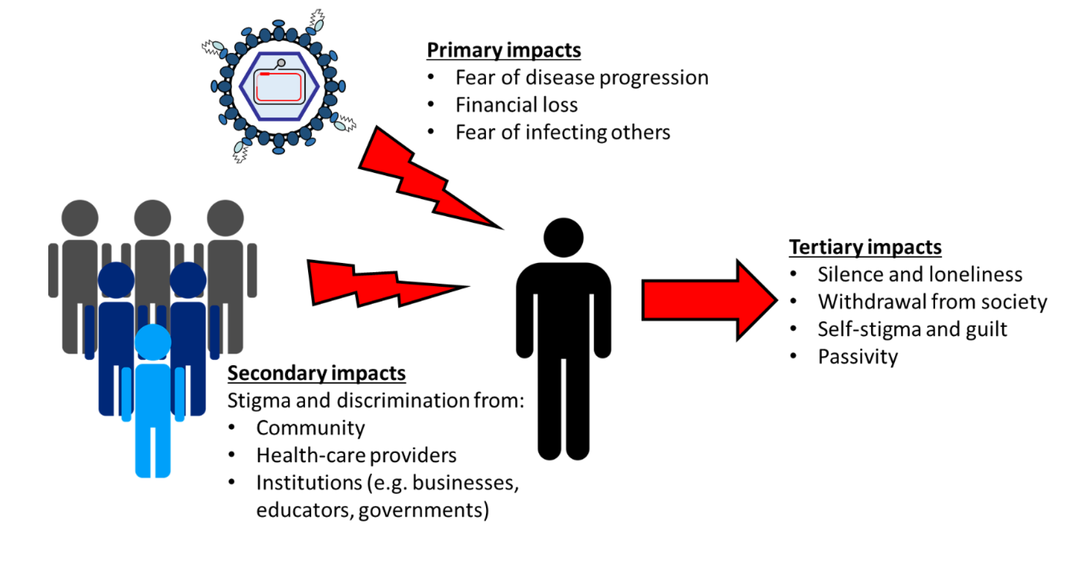
Psychosocial Impacts of Living with HBV
Tu T, Block JM, Wang S, Cohen C, Douglas MW. The Lived Experience of Chronic Hepatitis B: A Broader View of Its Impacts and Why We Need a Cure. Viruses. 2020 May 7;12(5):515. doi: 10.3390/v12050515. PMID: 32392763; PMCID: PMC7290920.

Slide 51
Why should patient perspectives be heard on the Road to Cure?
To clarify the rationale for finding a cure (e.g., “Why does a cure matter?”);
To understand if proposed treatment interventions would be useful (e.g., “Is the cure that I am proposing going to be practical in the real world?”);
To avoid any unintentional harm to the affected community (e.g., by exacerbating stigma);
To maintain a trusting and respectful relationship between the scientific community and affected communities.
Tu T, Block JM, Wang S, Cohen C, Douglas MW. The Lived Experience of Chronic Hepatitis B: A Broader View of Its Impacts and Why We Need a Cure. Viruses. 2020 May 7;12(5):515. doi: 10.3390/v12050515. PMID: 32392763; PMCID: PMC7290920.

Slide 52
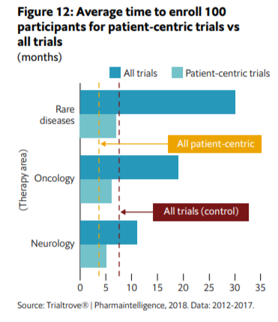
On the road to HBV Cure, we need patient involvement
Patient-centric trials involve patients in design & execution
Designed to improve relevance to patients & encourage participation in trials
Could impact: inclusion/exclusion criteria, visit burden in trial, patient relevent outcomes
Patient centered trials more likely to produce drugs that launch (87%) vs standard trials (68%)*
*The Innovation Imperative: The Future of Drug Development Part I: Research Methods and Findings, A report by The Economist Intelligence Unit, 2019 https://druginnovation.eiu.com/wp-content/uploads/2019/05/Parexel-innovations-in-drug-development-part-1_V14.pdf

Slide 53
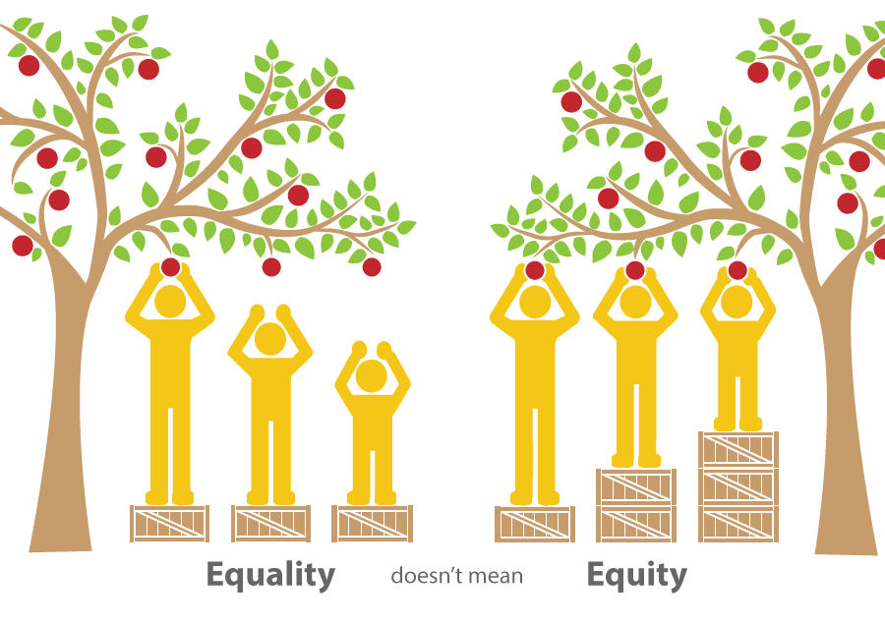
We won’t achieve viral hepatitis elimination without addressing health equity
  We have the tools.
  We can screen, vaccinate, and treat hepatitis with medication & cures.
  But the people most at-risk don’t have access.

Slide 54
Patients are slipping through the cracks
CDCs Chronic Hepatitis Cohort Study (CHeCS) for Hepatitis B
Study of 2338 HBV patients at US integrated health care systems known for providing high quality care (2013-16)
ALT testing in HBV patients
  78% of patients had ≥ 1 ALT done per year
HBV DNA testing in HBV patients
  Only 37% had ≥ 1 HBV DNA per year in care
  18% never had HBV DNA tested
People with HBV & cirrhosis
  Treatment (should be 100%)
  Only 56% prescribed antiviral tx
  HBV DNA
  54% with HBV DNA annually, 35% < annually, 11% never had HBV DNA done
  HCC screening
  53% had ≥ 1 hepatic imaging but only 27% had annual imaging
Spradling, PR, et al. ”Infrequent Clinical Assessment of Chronic Hepatitis B Patients in United States General Healthcare Settings”. Clin Infect Dis. 2016 Nov 1;63(9):1205-1208. Epub 2016 Aug 2.
Notes:
So we have all these great guidelines but what is happening in the real world? Are they being followed
CDC funded a multi site study at integrated health systems with primary care and specilaists- Kaiser is a leader in providing standardized qulality measure based care
Henry Ford has an excelent liver program and Giesinger is always winning awards
2K HBV patients
18% didn’t have HBV DNA and yet they the majority had an ALT so there is a missed opportunity
And maybe we need the EMR to prompt the docs when they order the ALT to add on the HBV DNA
Messy health care sstems

Slide 55
Many Guidelines for Hepatitis B Treatment: Which to Follow?
If we don’t simplify, patients will not get treated
Guideline | HBeAg+ |  | HBeAg-
 | HBV DNA IU/mL | ALT U/L | HBV DNA IU/mL | ALT U/L
AASLD 2018 | >20,000 | >2 x ULN‡ or significant histological disease | >2,000 | >2 x ULN‡ or significant histological disease
AATA 2018 | >2,000 | >ULN | >2,000 | >ULN
EASL 2017 | ≥2000 ≥20,000 | >ULN and/or at least moderate liver necroinflammation or fibrosis >2 x ULN irrespective of fibrosis | ≥2,000 ≥20,000 | >ULN and/or at least moderate liver necroinflammation or fibrosis >2 x ULN irrespective of fibrosis
JSH 2017 | ≥2,000 | >ULN^ | ≥2,000 | >ULN^
APASL 2015 | ≥20,000 | Varies | ≥2,000 | Varies
US Algorithm 2015† | ≥2000 | >ULN | ≥2,000 | >ULN
† If patients with HBV DNA ≥ 2000 IU/mL and elevated ALT without fibrosis do not undergo treatment, monitor HBV DNA and ALT every 3–6 months.
*Liver biopsy Stages 1–3, Grade 1–3; and/or Risk Impact Score ≥3;
‡ ALT ULN: Males 35 U/L, females 25 U/L ^ ALT ULN: 31 U/L
AASLD: American Association for the Study of Liver Diseases; AATA: Asian American Treatment Algorithm; ALT: alanine aminotransferase; APASL: Asian Pacific Association for the Study of the Liver; CHB: chronic hepatitis B; EASL: European Association for the Study of the Liver; HBeAg: hepatitis B e antigen; ULN: upper limit of normal; JSH, Japan Society of Hepatology
Terrault NB et al. Hepatology 2018; Published online February 5, 2018: doi:10.1002/hep.29800
Tong MJ, Pan CQ, Han SB, et al. An expert consensus for the management of chronic hepatitis B in Asian Americans. Aliment Pharmacol Ther. 2018
EASL Clinical Practice Guidelines on the management of hepatitis B virus infection. J Hepatol 2017; doi: 10.1016/j.jhep.2017.03.021
JSH Guidelines for the Management of Hepatitis B Virus Infection. 2017
Sarin SK, et al. Hepatol Int 2015; doi 10.1007/s12072-015-9675-4; Martin P, et al. Clin Gastroenterol Hepatol 2015;13: 2071–87
Martin P, et al. Clin Gastroenterol Hepatol 2015; Published online July 15, 2015: http://dx.doi.org/10.1016/j.cgh.2015.07.007

Slide 56
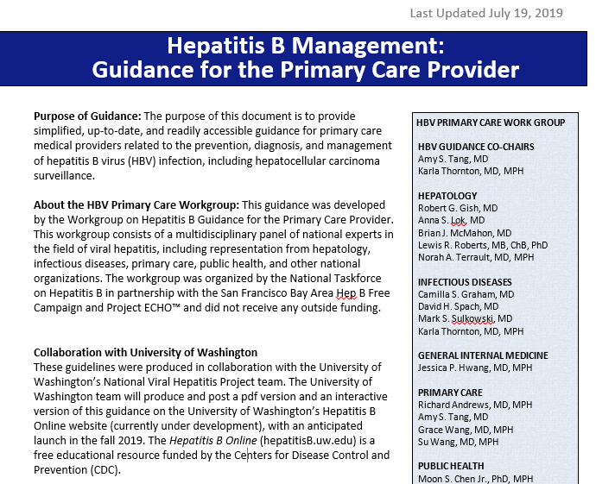
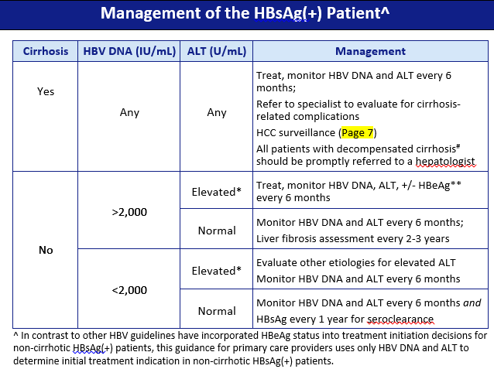

Slide 57
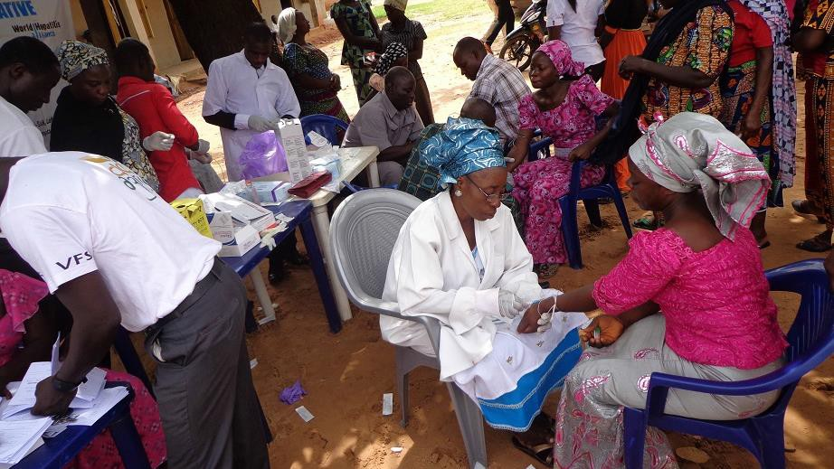
ELIMINATION
will not be achieved without involving
PEOPLE WHO ARE AFFECTED
by viral hepatitis
Notes:
I feel like this conference has embraced this and I have seen this

Slide 58

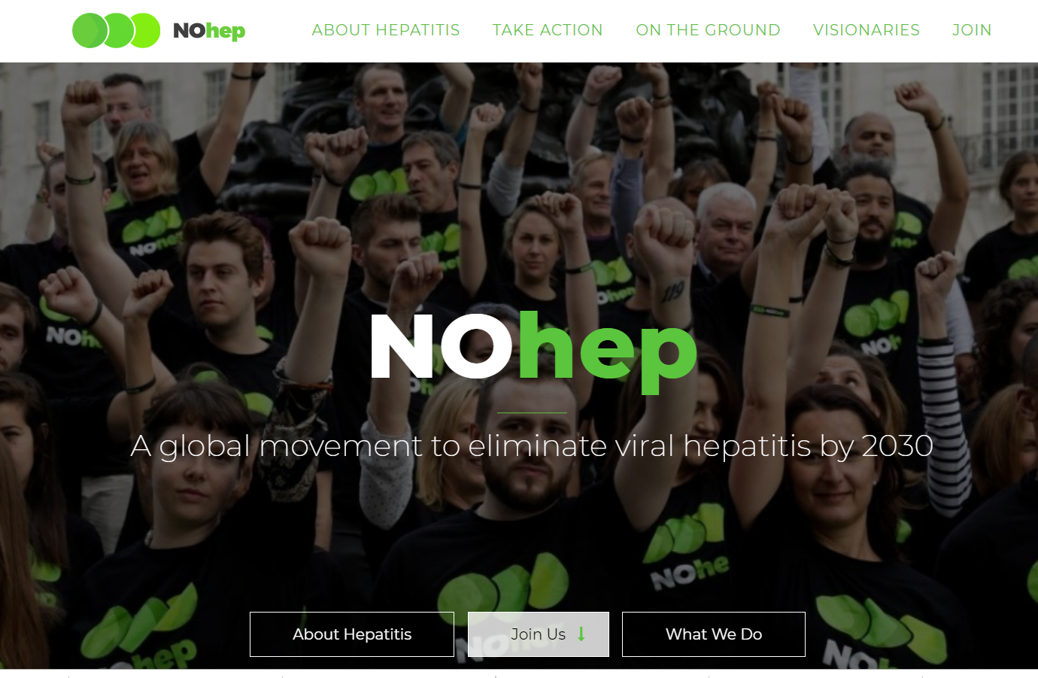




It will take a village
Notes:
… is a sign that something is coming next
Is a sign of movement to indicate that this is our next achievement
Like the … you see when a text is coming in
The color green is fresh, vitality

Slide 59
Please type your questions in the Question Box.
Questions?

Slide 60
Thank you for joining!
connect with us: Hepatitis B Foundation’s Hep B United Coalition connect@hepbunited.org /
info@hepb.org
www.hepbunited.org / www.hepb.org

